Slide 1

Online market project
By: Amanuel tesfamichael, Musie Araia, Amanuel Emha, Zeresenay Fsehaye, and Henok welday

Slide 2


Problem description
We need to specify a new system called Online Market; it is going to be an ecommerce site. This is a system where sellers can upload their products on this website to sell and buyers can buy products from these sellers.
Seller:
Seller can add products once he/she is approved by Admin (as a registered Seller).
Seller cannot buy products from this website.
Seller can cancel an order placed by a buyer.
Seller can delete a product but if there is an order with that product, the product cannot be deleted.
Seller gets email notifications of placed orders.
Buyer:
Buyer cannot sell items on this website.
Buyer can add/edit/delete products to the shopping cart.
Buyer can have a log of his/her past orders.
Order payment is handled by a third party.
Buyer can cancel an order before it gets shipped.
Buyer can download a pdf receipt of the order.
Buyer can write a product review.
Buyer will get email notification of their purchased product.
Admin:
Admin can approve sellers’ registration
Admin approves product reviews made by buyers

Slide 3
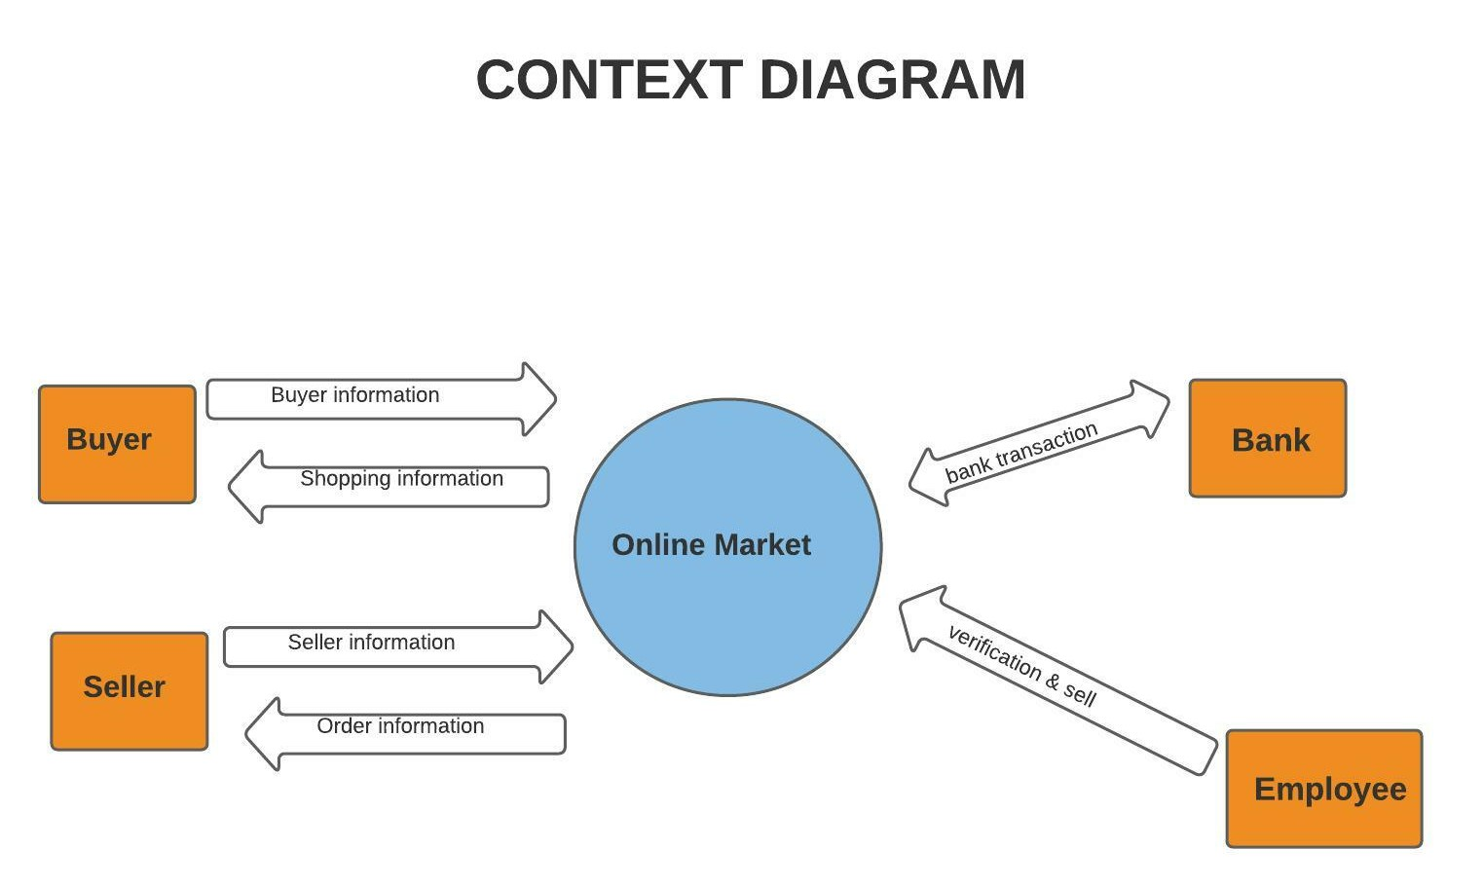
Context diagram

Slide 4
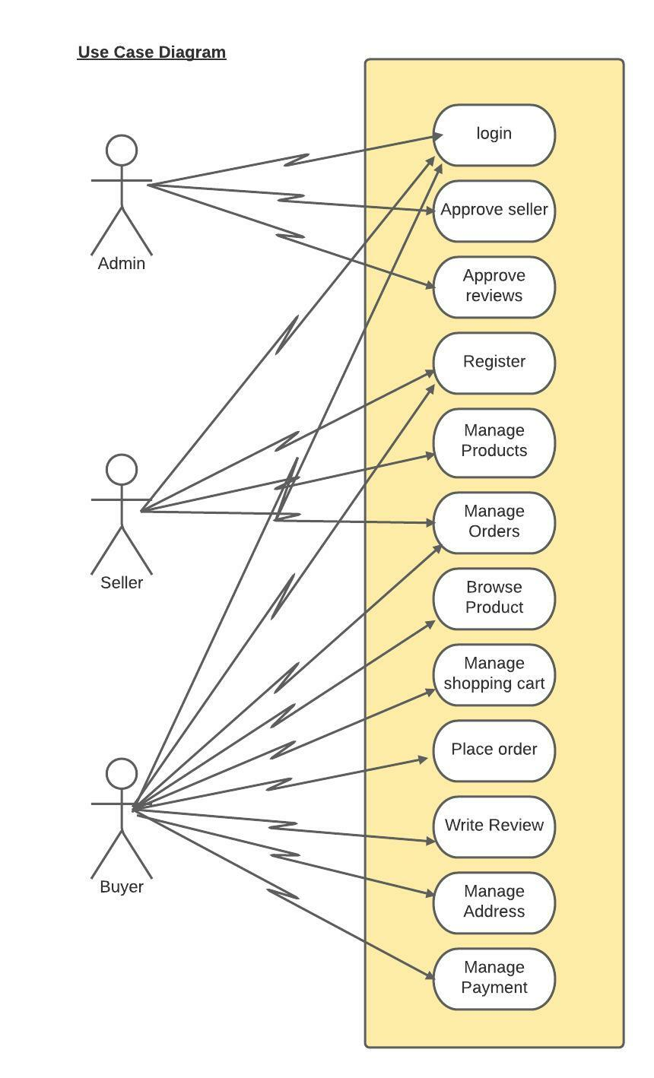
Use case diagram

Slide 5
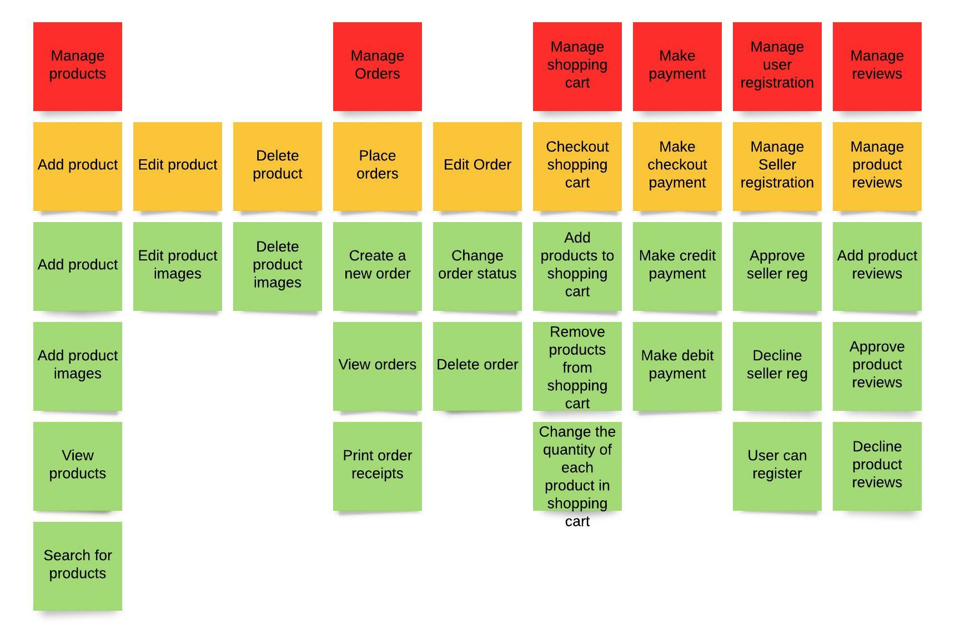
User story map

Slide 6
Acceptance criteria
Product quantity should be more than zero.
Product must have name
Product must have description.
Product must have price.
Product cannot be a duplicate of another from the same seller.
Only new products no used ones.
As a seller I can add product to be sold in the market so that my products can be seen by buyers.

Slide 7
Acceptance criteria
Order must contain at least one product.
Order must have shipping address.
Order must contain valid payment info.
Payment must be accepted first.
Product must be in-stock.
As a buyer I can check out my shopping cart (order) so that I can buy products.

Slide 8
Acceptance criteria
User must be registered as seller.
User must provide email.
User must provide full name.
As an admin I can approve seller registration so that approved sellers sell their product in the site.

Slide 9
Scenarios add product:
1. Seller logs in the system
2. System shows all seller products and an option to add product.
3. Seller chooses to add product.
4. System displays new product form.
5. Seller enters product name, description, quantity, images, and price, and submits it.
6. System displays a success message of adding a product.
7. System goes back to point #2.
If seller enters wrong data in the form fields:
6. System displays error message above each required field.
7. Seller corrects info and submits again.
8. system displays success message of adding a product.
9. System goes back to point #2.
If product is a duplicate for the same seller:
6. System displays message mentioning this is a duplicate product.
7. Seller corrects info and submits again.
8. system displays success message of adding a product.
9. System goes back to point #2.

Slide 10
Scenarios checkout shopping cart:
1. Buyer enters login info.
2. System displays all products.
3. Buyer adds Products to the cart.
4. Buyer requests shopping cart checkout.
5. System displays the products in the shopping cart and total price.
6. Buyer confirms this.
7. System displays checkout form.
8. Buyer enters shipping address, payment details, billing address and then submits.
9. System displays placed order receipt and options to download the receipt and an option to go back to all products view.
If product is out of stock:
3. System displays an out-of-stock message.
4. System goes back to all products view.
5. Buyer adds other products to the shopping cart.
6. continue at point 4 of the main scenario.
If payment fails:
9. The system displays a message that payment is not valid.
10. Buyer enters different payment information.
11. continue at point 9 of the main scenario.
If Address requirements are missing:
9. The system will display an error over the required address info.
10. Buyer will enter correct info and submit.
11. continue at point 9 of the main scenario.

Slide 11
Scenarios approve seller registration:
1. Admin enters the login credentials.
2. The system displays an option to the list of newly registered sellers and an option to the list of reviews.
3. Admin selects list of sellers.
4. System displays the list of newly registered sellers that are pending to be approved.
5. Admin selects approve seller on a seller of his/her choice.
6. System displays a success message.
7. System goes back to point #4.
If admin denies seller:
5. Admin selects deny seller on a seller of his/her choice.
6. System displays that seller has been successfully denied.
7. Continue at point 4 of the main scenario.

Slide 12
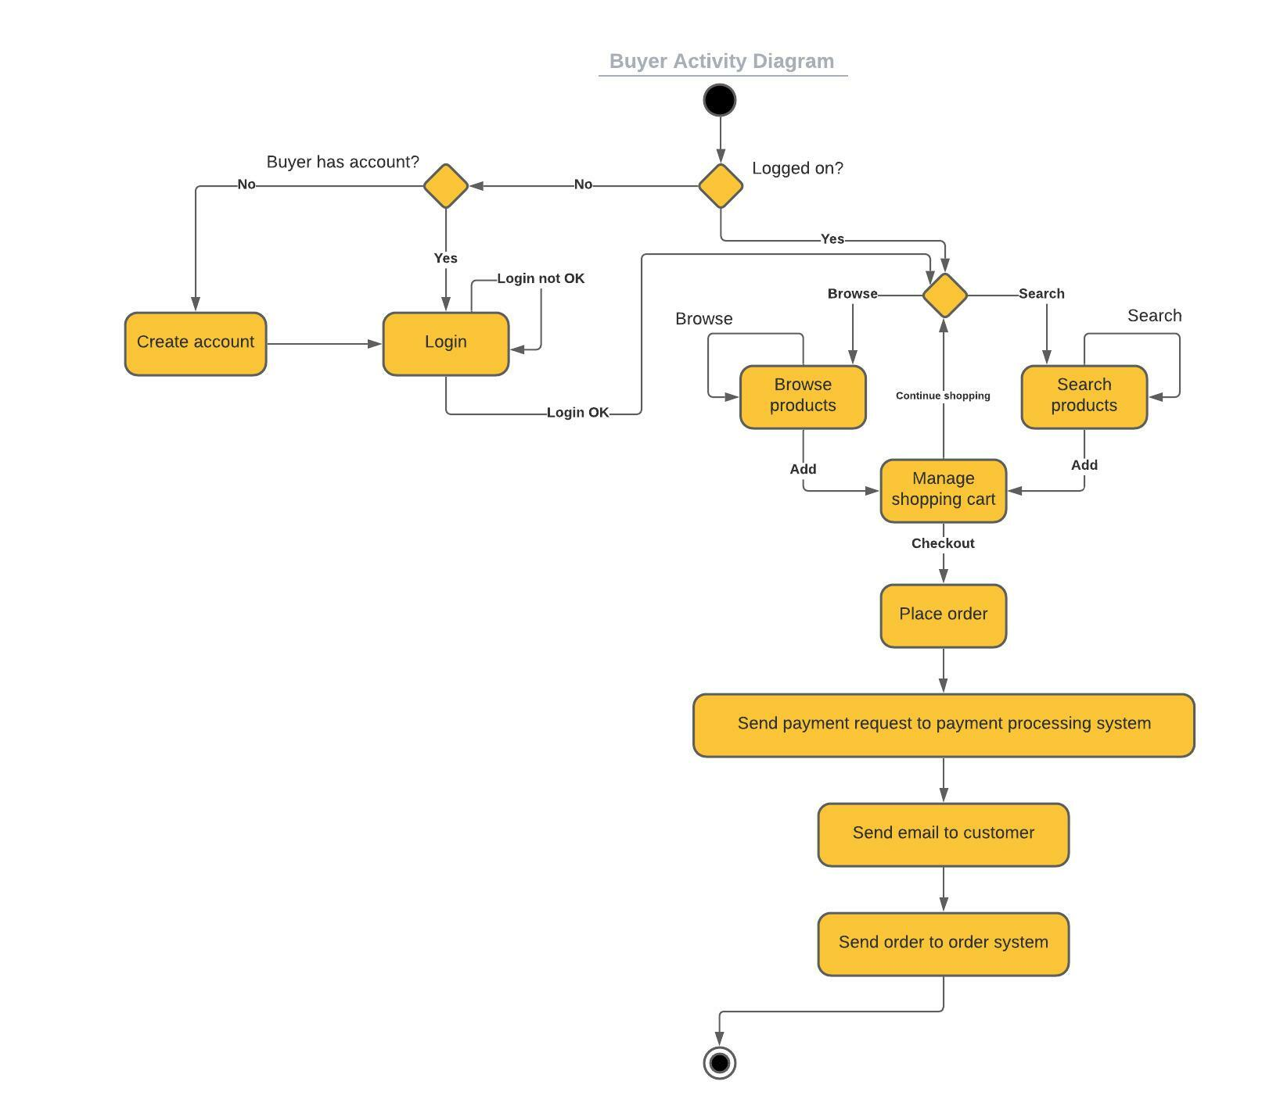
Buyer activity diagram

Slide 13
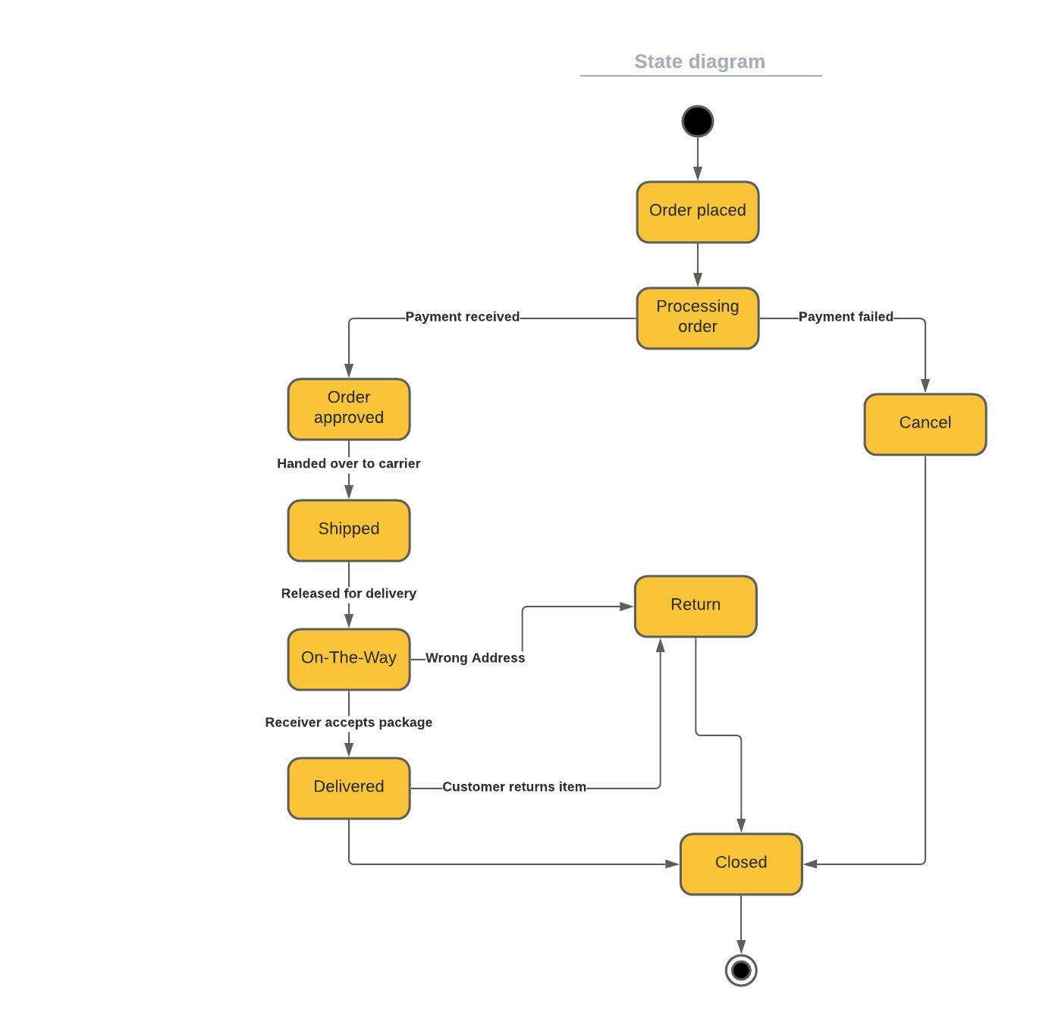
State diagram

Slide 14
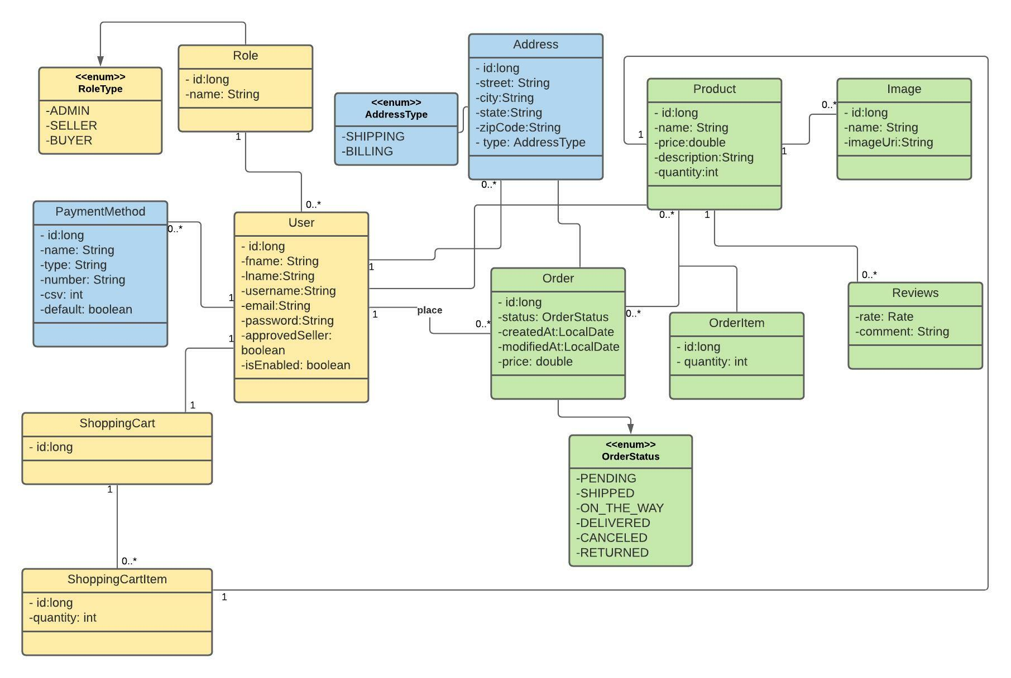
Class diagram

Slide 15
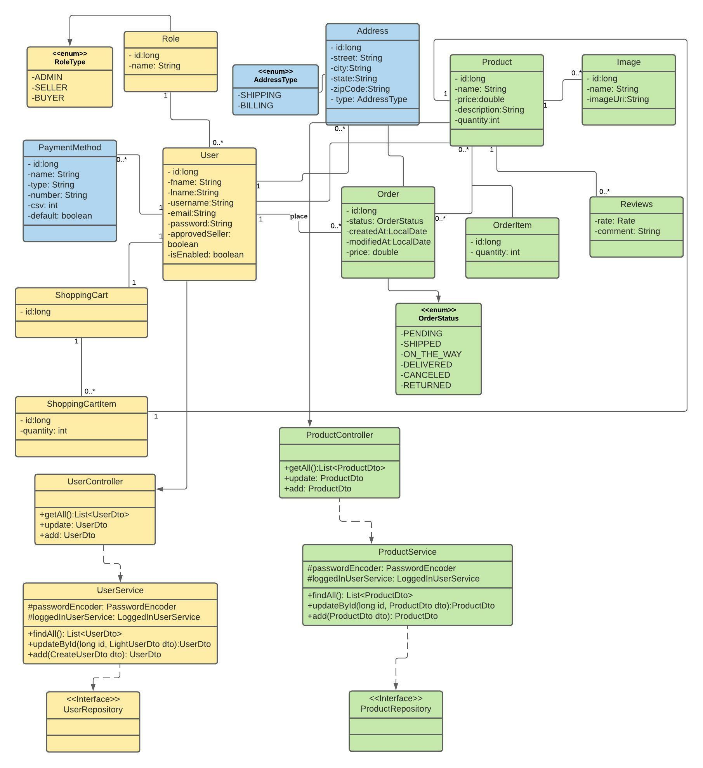
Class diagram

Slide 16
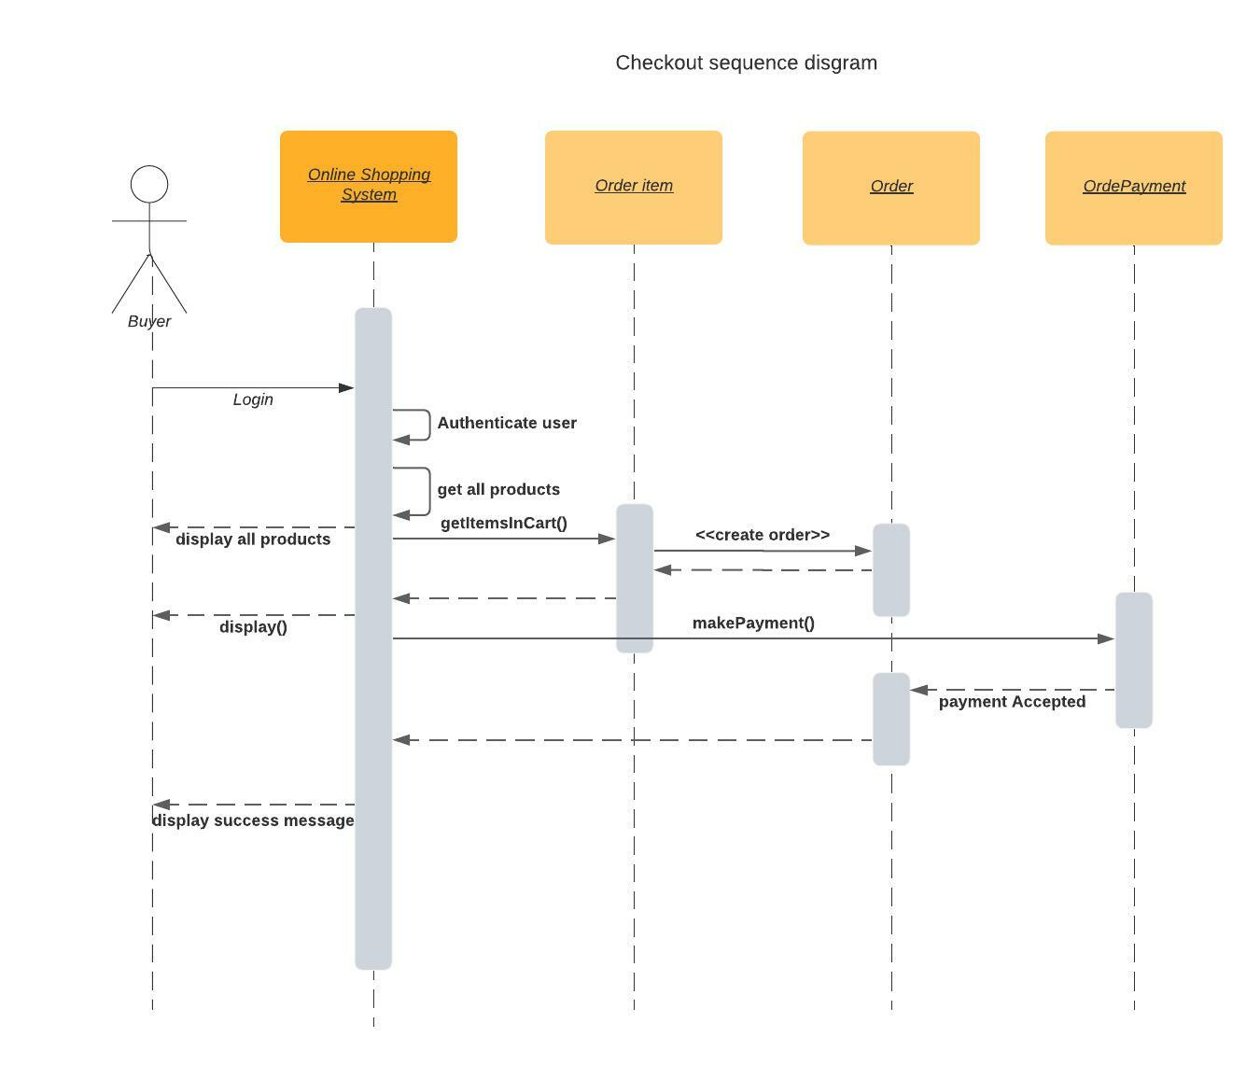
Checkout sequence diagram

Slide 17
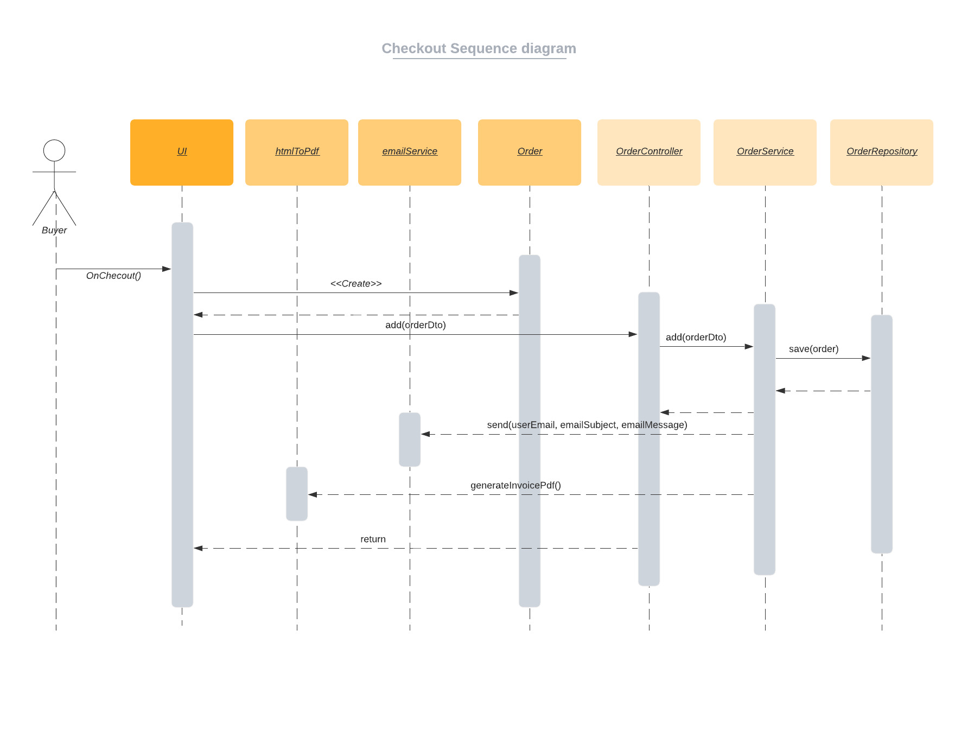
Checkout sequence diagram

Slide 18
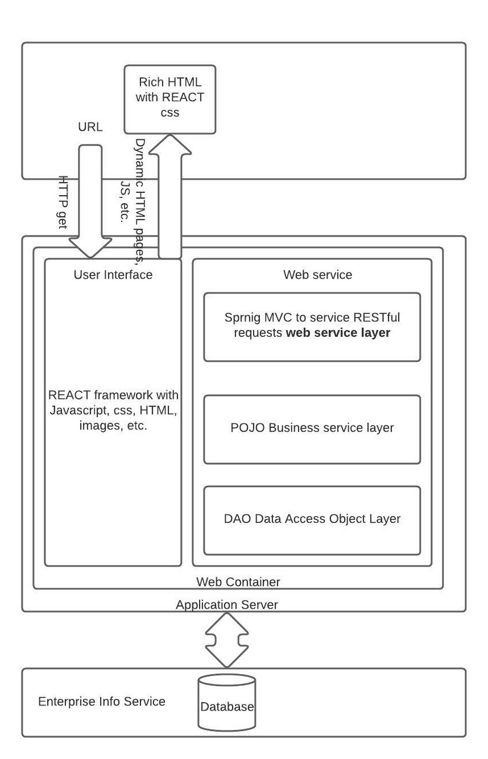
Solution architecture

Slide 19
Porject Frontend Demo

Slide 20
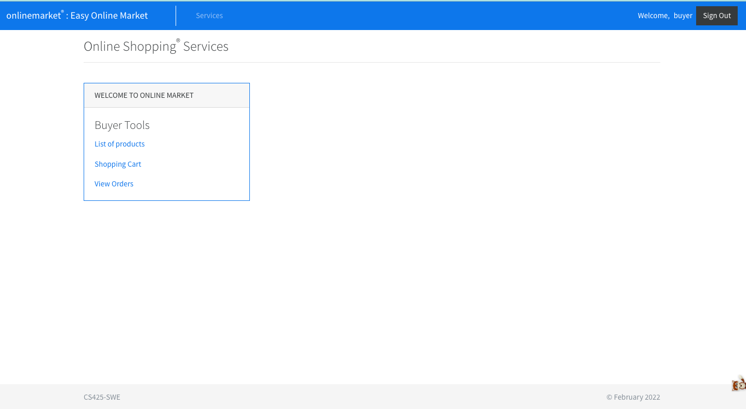
buyer page

Slide 21
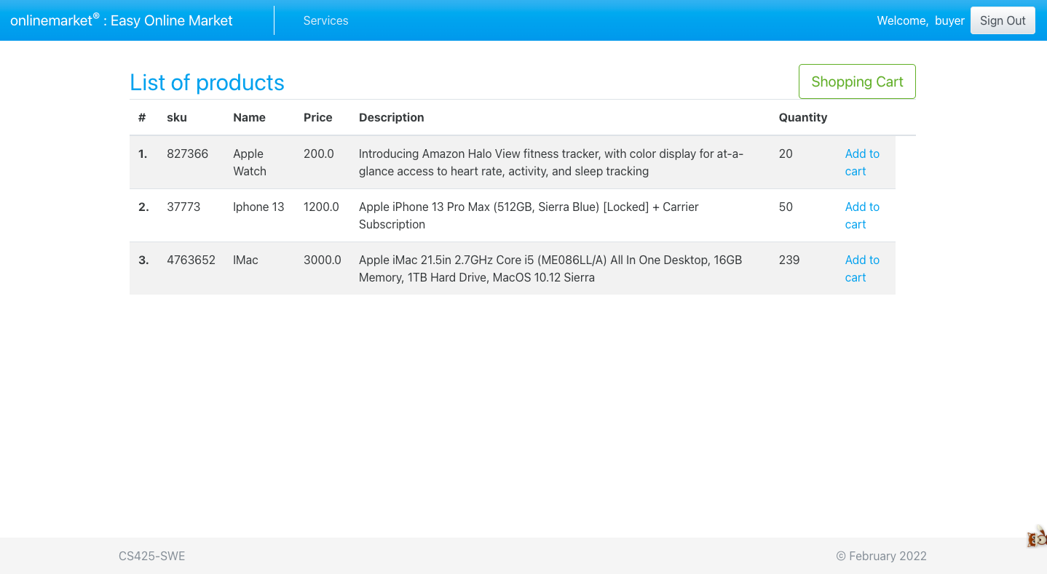
buyer page

Slide 22
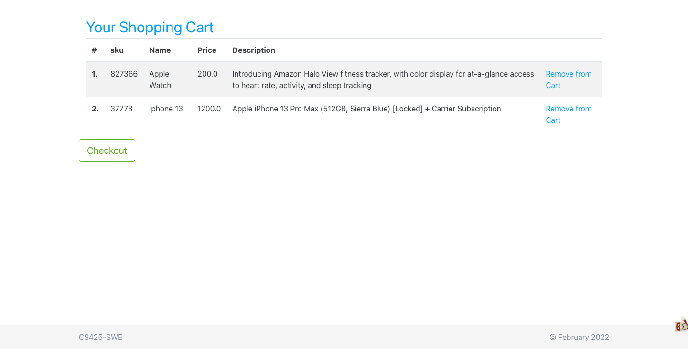
buyer page

Slide 23
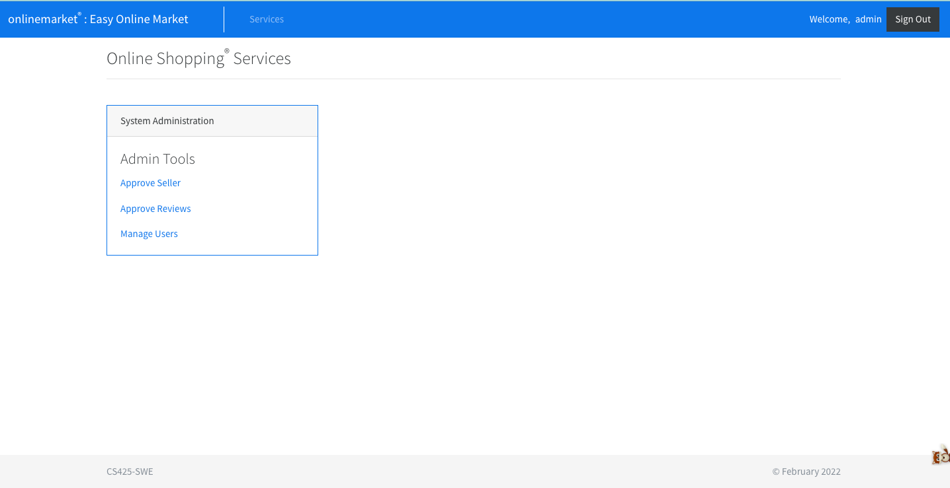
Admin page

Slide 24
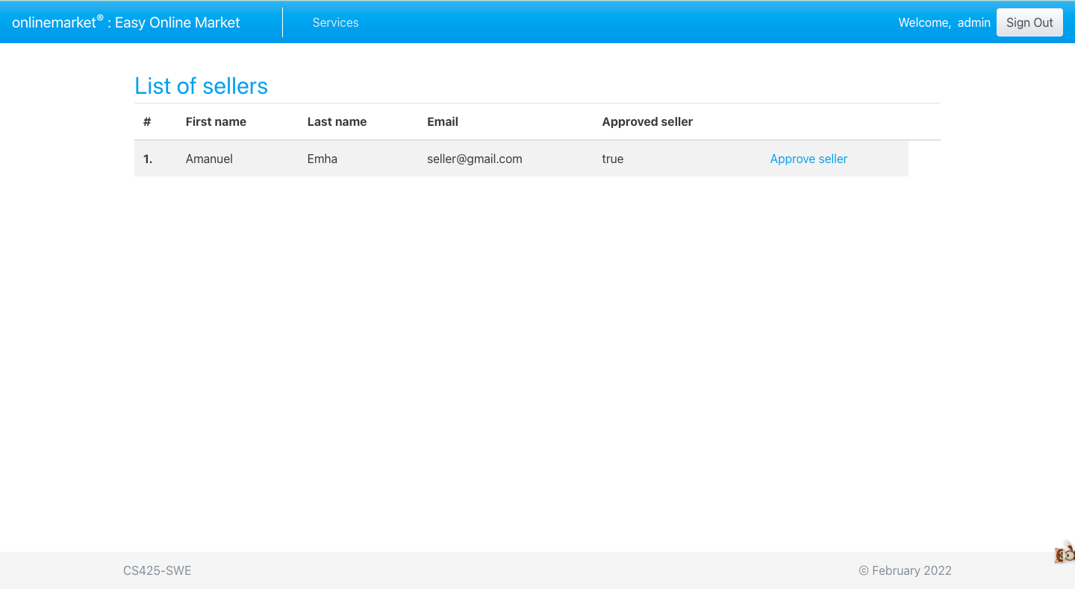
Admin page- approve seller

Slide 25
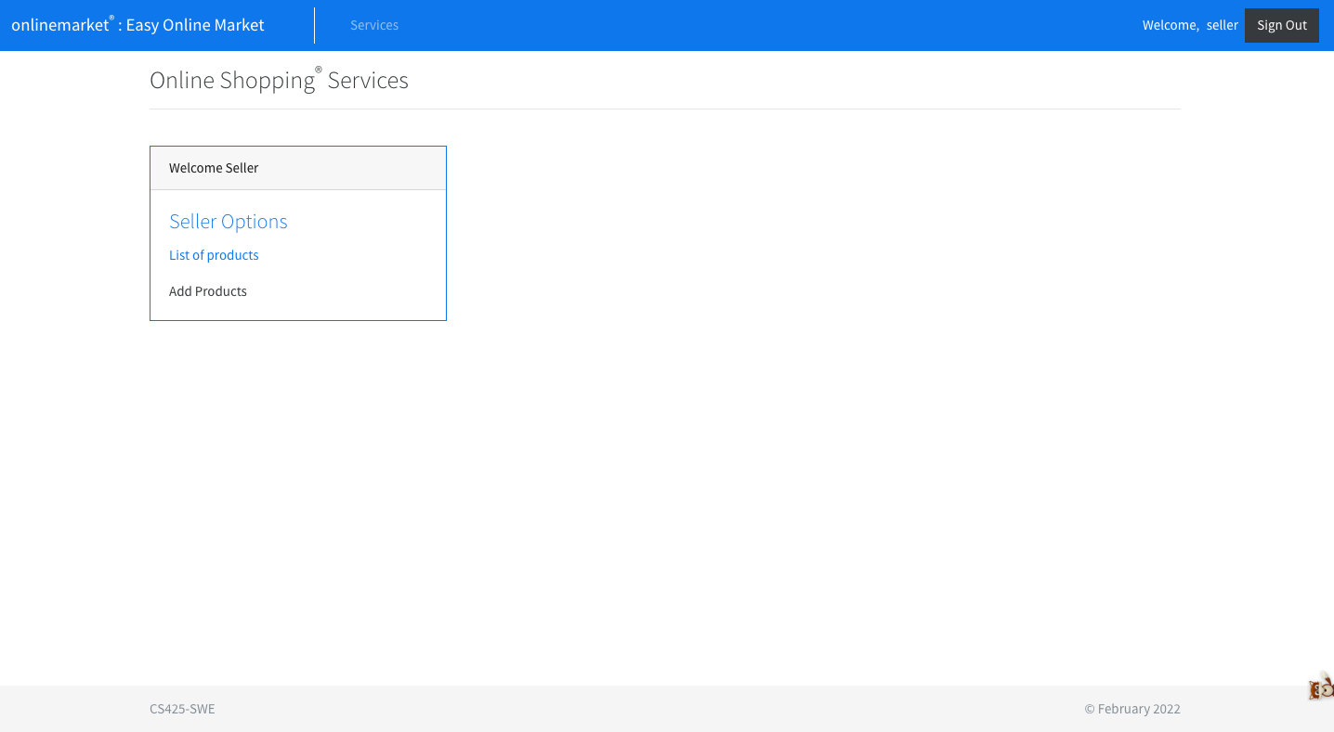
Seller page

Slide 26
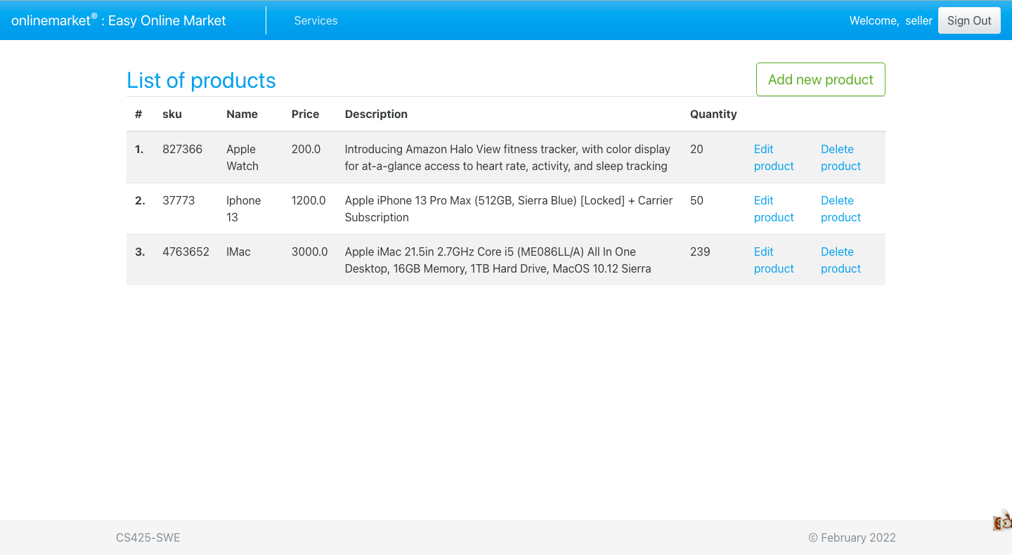
Seller page (Add, Edit and remove products)

Slide 27
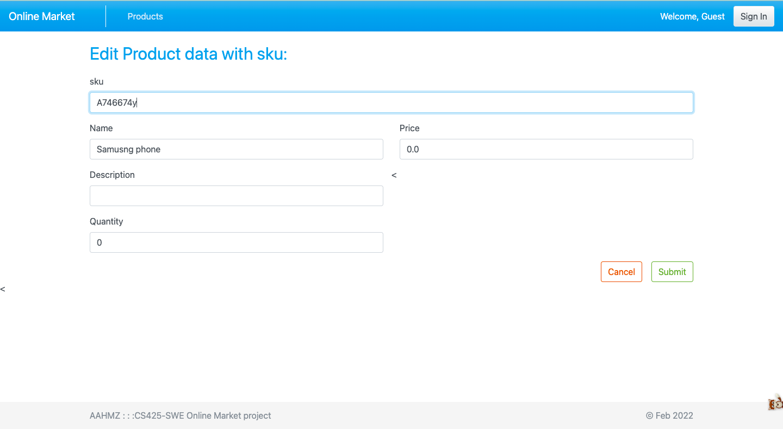
Seller page

Slide 28
Online market project
Thank you!
By: Amanuel tesfamichael, Musie Araia, Amanuel Emha, Zeresenay Fsehaye, and Henok welday

